Slide 1
Magnetism
Year 7 Science

Slide 2
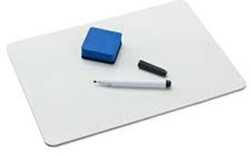
Lab Vocab
friction
gravity
weight
magnet
temporary
Permanent
Field
experiment

Slide 3
Learning Intentions
Investigating the effects of applying different forces to familiar objects

Slide 4
Success criteria
Classify materials as magnetic or non-magnetic.
Describe interactions of magnetic fields.

Slide 5


Slide 6
What do we mean by ‘magnetic’ ?

Slide 7
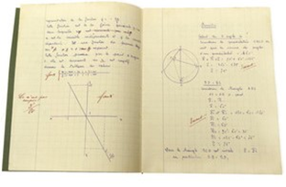
Magnetism 2/08/2024
Material or object | Magnetic or non-magnetic

Slide 8
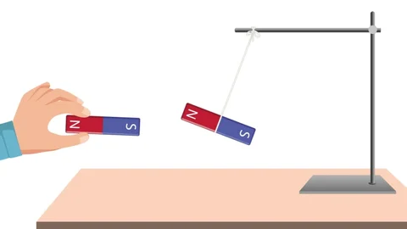
Activity2: Magnetic Forces
Part 2 – Testing forces between magnets.

Slide 9
Success criteria
Classify materials as magnetic or non-magnetic.
Describe interactions of magnetic fields.

